Slide 1

MAJOR PROJECT :SMART BINS
Submitted By :
Kanak varshney
Naman gupta
Prankur Tiwari
Shubhangi agrawal
Guided BY:MS rosy verma

Slide 2
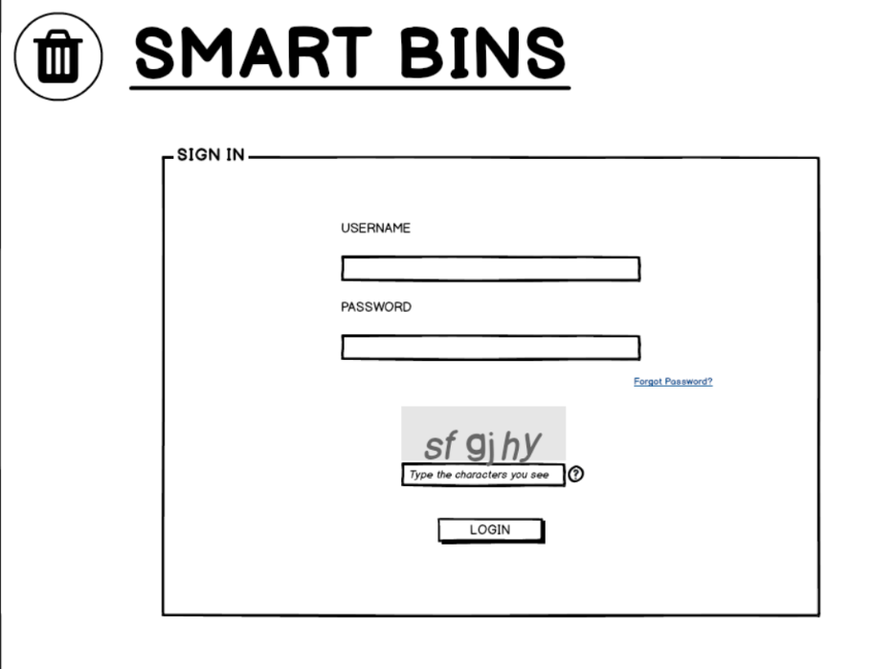
Graphical user interface

Slide 3
Tools and Technology Used
HTML ,CSS ,bootStrap
JAVA SERVER PAGES (JSP)
Java database connectivity (jdbc)
IntelliJ IDE
Postgresql DBMS
GIT version control system

Slide 4
DATA FLOW DIAGRAM
Context level diagram
Level 1st DFD

Slide 5
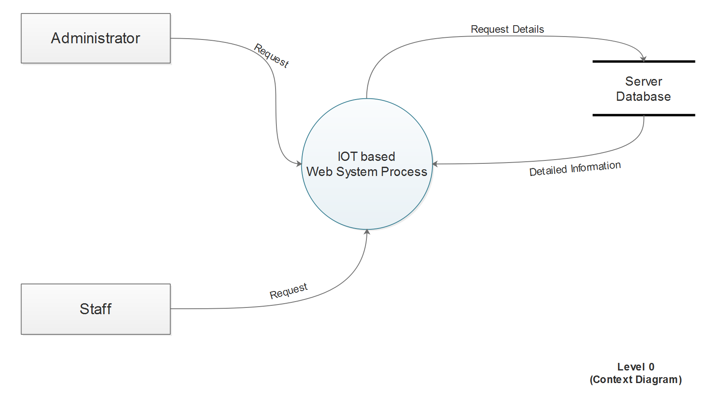

Slide 6
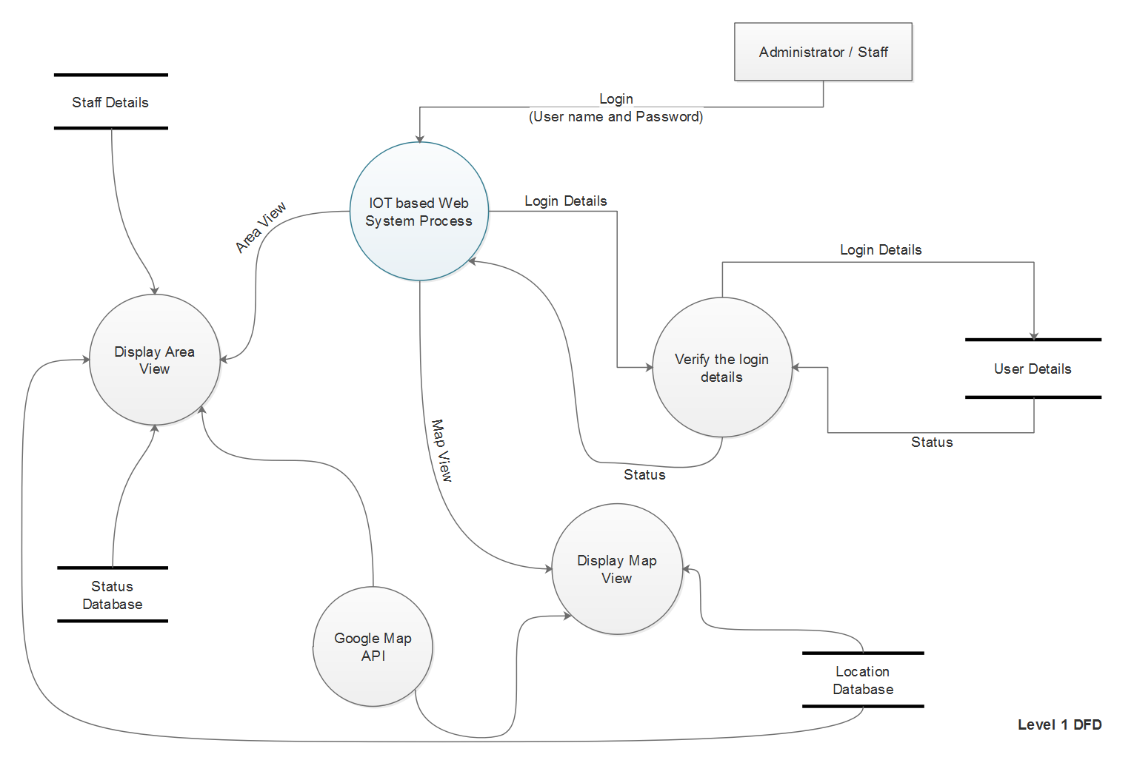

Slide 7
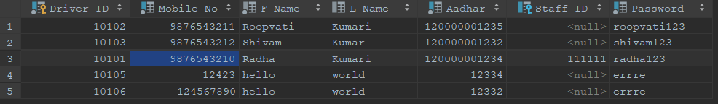
DATABASE
Table: Staff
Table:DRIver

Slide 8
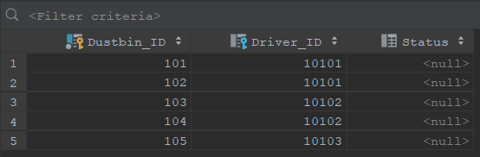
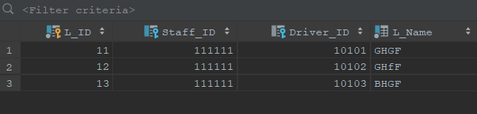
DATABASE (CONTINUE)
Table: Dustbin
Table: location

Slide 9
DATABASE CONNECTIVITY (JDBC)
import java.sql.Connection; import java.sql.DriverManager; import java.sql.PreparedStatement; import java.sql.ResultSet; public class demo { public static void main(String args[]) { try{ Class.forName("org.postgresql.Driver"); Connection con = DriverManager.getConnection("jdbc:postgresql://localhost:5432/SmartBins", "postgres", "behenchod101"); PreparedStatement driver = con.prepareStatement("select * from public.\"Driver\""); PreparedStatement staff = con.prepareStatement("select * from public.\"Staff\""); PreparedStatement dustbin = con.prepareStatement("select * from public.\"Dustbin\""); PreparedStatement location = con.prepareStatement("select * from public.\"Location\""); ResultSet rs = driver.executeQuery(); ResultSet rs1 = staff.executeQuery(); ResultSet d1 = dustbin.executeQuery(); ResultSet l1 = location.executeQuery();

Slide 10
System.out.println("Drivers Table is"); while (rs.next()){ System.out.println(rs.getLong(1)+" "+rs.getLong(2)+" "+ rs.getString(3)+" "+rs.getString(4)+ " "+rs.getLong(5)+" "+rs.getLong(6)+" "+rs.getString(7)); } System.out.println("Staff table is"); while ((rs1.next())) { System.out.println(rs1.getLong(1)+" "+rs1.getString(2)+" "+rs1.getString(3)+" "+rs1.getLong(4)+" "+rs1.getLong(5)+" "+rs1.getString(6)); } System.out.println("Dustbin Table is"); while ((d1.next())) { System.out.println(d1.getLong(1)+" "+d1.getLong(2)+ " "+ d1.getInt(3)); } System.out.println("Location table is"); while (l1.next()) { System.out.println(l1.getLong(1)+" "+l1.getLong(2)+" "+l1.getLong(3)+" "+l1.getString(4)); } } catch (Exception ex) { System.out.println(ex.getMessage()); } } }

Slide 11
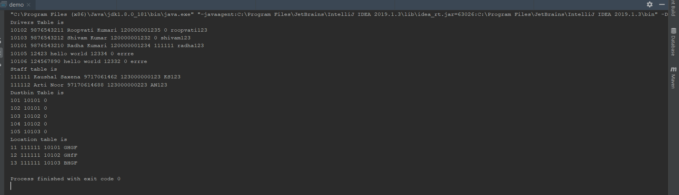
JDBC Code OUTPUT

Slide 12
REFERENCES
[1] https://www.youtube.com/watch?v=43RXzu2SuJg (12-August-2019)
[2] http://www.postgresqltutorial.com/postgresql-sample-database/ (28-July-2019)
[3] http://www.postgresqltutorial.com/postgresql-jdbc/connecting-to-postgresql-database/ (12-August-2019)
[4] https://www.youtube.com/watch?v=aUfPf-clLLs (20-July-2019)
[5] https://github.com/shubhangiagarwal76/SmartBins (18-August-2019)
[6] https://www.postgresql.org/docs/10/sql-altertable.html (12-August-2019)
[7] https://jdbc.postgresql.org/download.html (11-August-2019)
[8] https://balsamiq.com/tutorials/ (20-June-2019)
[9] https://www.geeksforgeeks.com (10-June-2019)

